Slide 1
Face Entropy
סיכום ביניים
Roy Zohar and Roy Mezan

Slide 2
Quick Reminder
Roy Zohar - 209896174
Roy Mezan - 319042800
Instructors:
Prof. Rita Osdachy
Dr. Orr Dunkelman

Slide 3
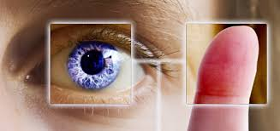
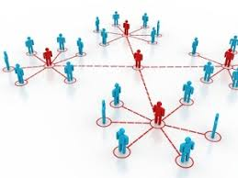
Quick Reminder
Our project was to find out what the face space looks like.
Conclude whether it is vulnerable to attacks (Too clustered?)

Slide 4

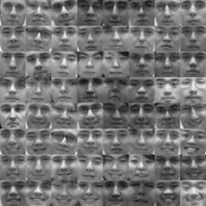
Quick Reminder
Subspace of face world that we believe we can cover most faces with

Slide 5
Another look at the schedule
We are here
Oct - Nov
Nov-Jan
Jan - Mar
Mar - May
Defining all of our data sources
Playing around with Dlib and creating faces
Running hamming distance from a group of faces
Results and finding enthropy
Dlib libraries, Face distributuions, Cloud computing, Data Servers.
Learning how to create faces based on output of dlib
Run using cloud computing to find the size of the face space
Concluding the results

Slide 6
What we have done
We found a Database with ~600 subjects with frontal images
We got to know the DLIB library and played around with it
We wrote a platform for working with face databases:
Reading
Writing
Attacking

Slide 7
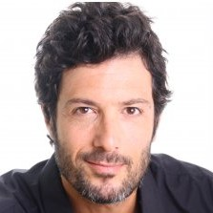

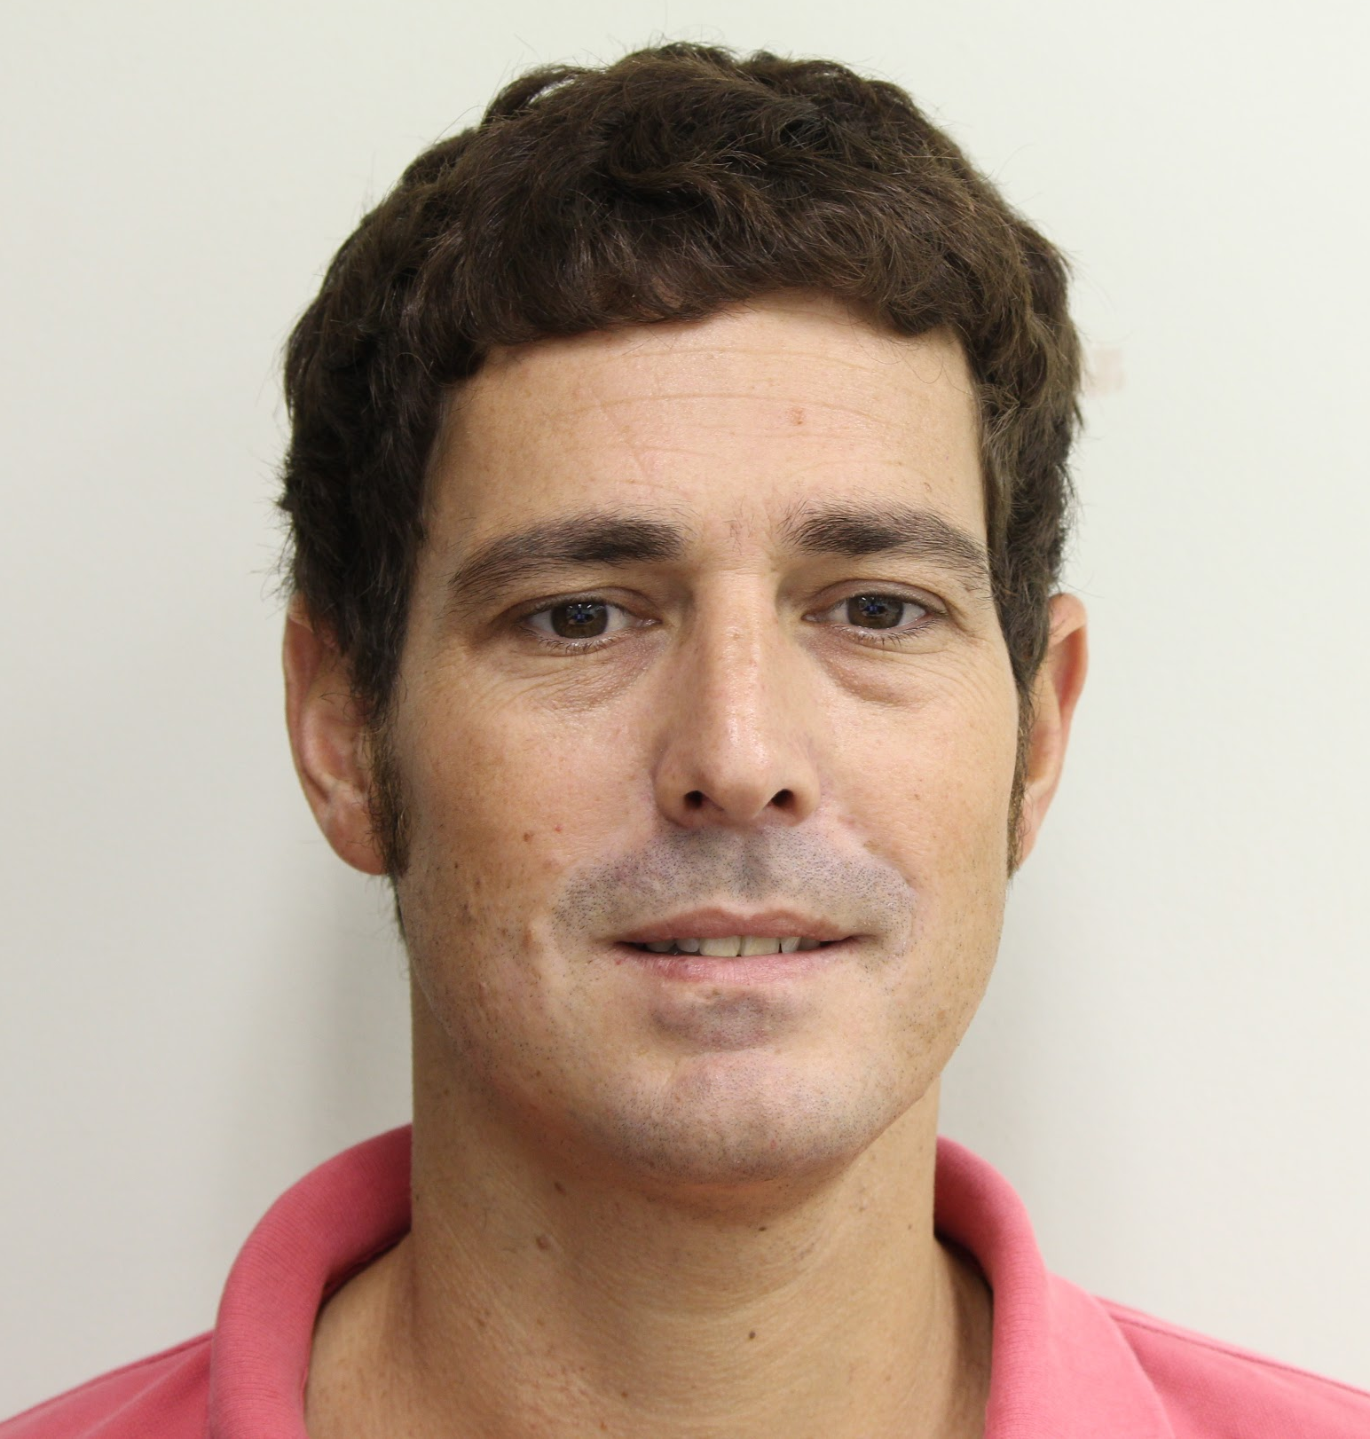
Progress - the Dlib Library

Slide 8
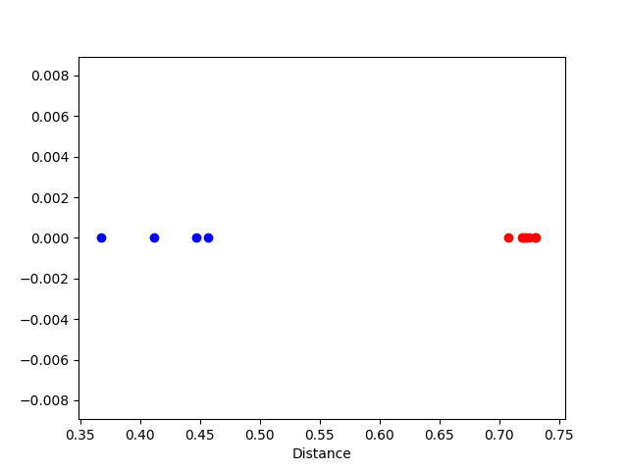
Progress - the Dlib Library
Ron VS. Ron
Ron VS. Oren

Slide 9

Progress - the Platform
Our main progress was in the platform area.
We coded the entire environment for reading and writing to face databases.
We implemented the PCA and inverse sampling.
Uploaded and documented everything: https://github.com/Royz2123/Biometric-Attack
Running any test now on any database is just a few lines of code.

Slide 10

Progress - the Attack
We have already run some tests on the database with some promising results:
Training our synthesizer with the real database gives some very good results!

Slide 11

What next?
Run the attack on a large sample in the cluster.
Tune threshold more accurately. Maybe 0.6 is too easy for the database.
Conclude and run more tests.

Slide 12

Thanks for listening!
Questions?

